Slide 1

RSA IMPLEMENTATION USING FPGA
Paper I’d 395
Group Members
Nitin singh
Riya Sharma
Nisha Chauhan
Project Supervisor : Rajeshwari Bhatt
DEPARTMENT OF ELECTRONICS AND COMMUNICATION ENGINEERING

Slide 2
Project Presentation Outline
Title of the Project
Problem statement
Objectives of the project
Block diagram of project
Methodology
References

Slide 3
Title of the Project:
RSA IMPLEMENTATION USING FPGA
DEPARTMENT OF ELECTRONICS & COMMUNICATION

Slide 4
Problem statement:
Achieving efficient and secure encryption/decryption is essential. RSA, a key algorithm, is slow when executed on software, especially with significant data or real-time demands. A hardware-based approach is required to accelerate RSA computations for better performance and effectiveness.
DEPARTMENT OF ELECTRONICS & COMMUNICATION

Slide 5
Objective of the Project
Achieving Security and accelerating the overall communication via :
1. Encryption (Public key)
2. Key Generation
3. Decryption (Private key)
Hardware Acceleration & Real-time Performance
DEPARTMENT OF ELECTRONICS & COMMUNICATION

Slide 6
METHODOLOGY
The RSA cryptosystem can be explained in only a few steps:
prime number generation, key generation, encryption, and decryption.
The RSA cryptosystem is based on two large prime numbers 𝑝, 𝑞 chosen at random at a set bit length such that p!= q and the multiplication of these numbers generate 𝑛 = 𝑝*𝑞. We then calculate 𝑝ℎ𝑖(𝑛) = (𝑝 −1)(𝑞− 1).
We then choose a public key e such that 1 <𝑒<𝑝ℎ𝑖(𝑛) and such that e is not divisible by 𝑝ℎ𝑖(𝑛). After this we can calculate the public key such that
𝑔cd(𝑝h𝑖(𝑛), 𝑒) = 1 (where e and phi(n) are relative primes.) We can then calculate our private key d such that 𝑑 =𝑒^(-1)𝑚od(𝑝ℎ𝑖(𝑛)) we choose a message m to generate a cipher text c such that 𝑐=𝑚^𝑒 𝑚od(𝑛) and decrypt our cipher to generate our original message m such that
𝑚=𝑐^𝑑 𝑚od(𝑛).
DEPARTMENT OF ELECTRONICS & COMMUNICATION

Slide 7
WORK FLOW
Key generation:
- Choose two large prime numbers, p and q.
- Compute n = p * q, which is the modulus.
- Compute the totient function, φ(n) = (p-1) * (q-1).
- Choose a number e, such that 1 < e < φ(n) and gcd(e, φ(n)) = 1 (e is the public key).
- Compute d, such that d * e ≡ 1 (mod φ(n)) (d is the private key).
Encryption:
- Given a plaintext message, M, to be encrypted, compute:
- Ciphertext, C = M^e (mod n)
Decryption:
- Given a ciphertext, C, to be decrypted, compute:
- Plaintext, M = C^d (mod n)
DEPARTMENT OF ELECTRONICS & COMMUNICATION

Slide 8
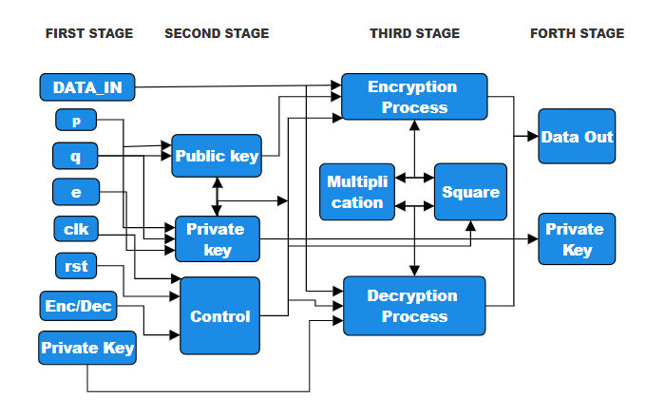
FLOW CHART
Conversion Of Plain Text To Cipher Text Using Public Key Encryption
DEPARTMENT OF ELECTRONICS & COMMUNICATION

Slide 9
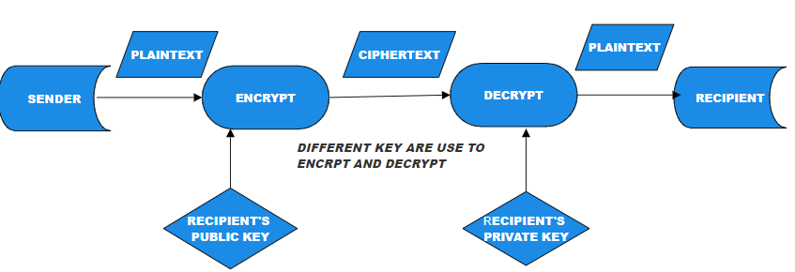
Work Flow & Key Formation
DEPARTMENT OF ELECTRONICS & COMMUNICATION

Slide 10
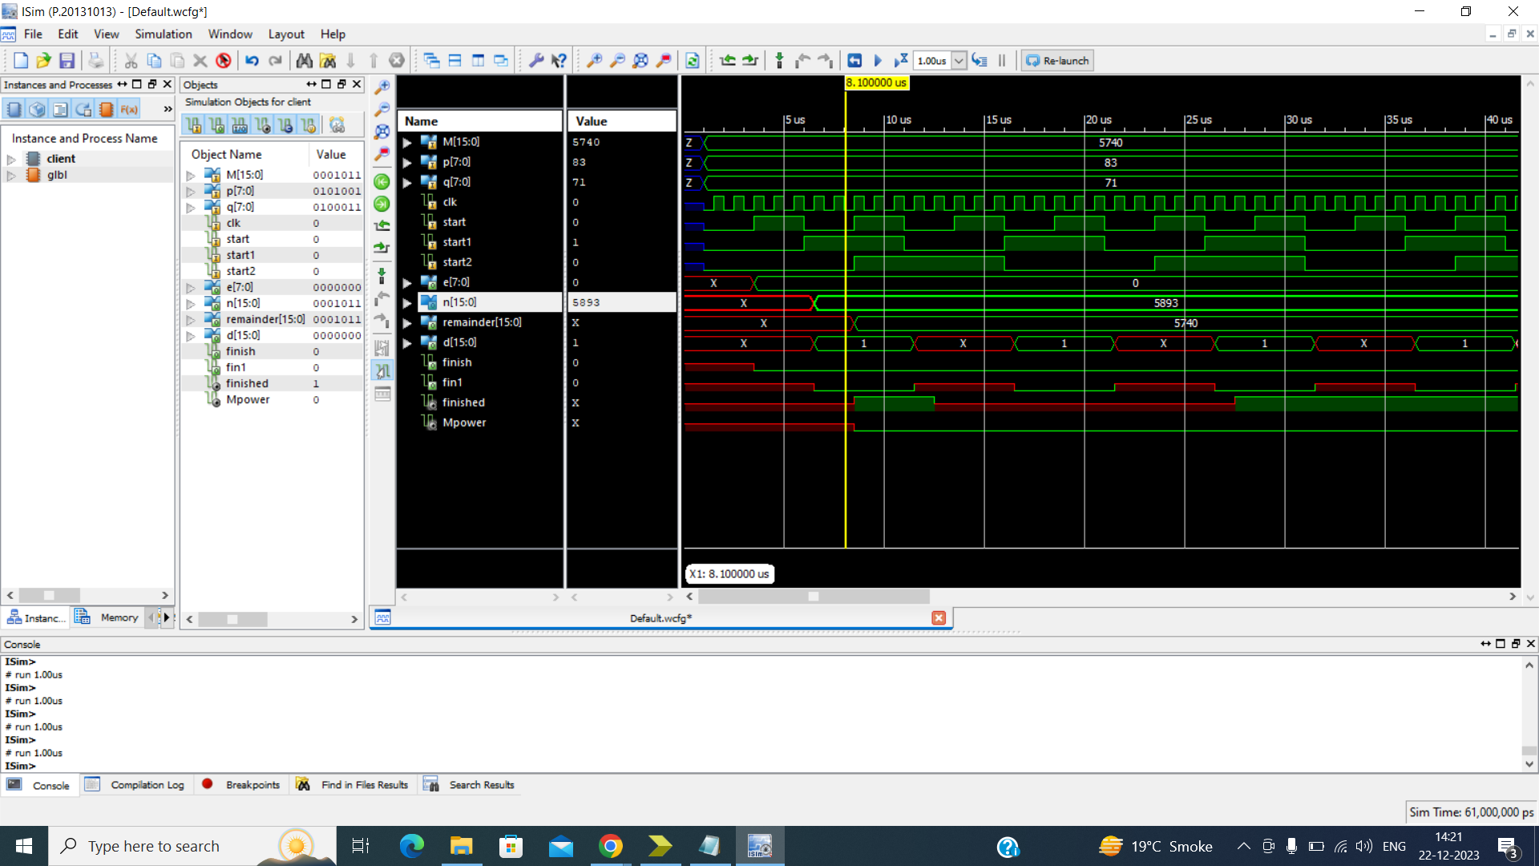
ENCRYPTION
(Client.v)
DEPARTMENT OF ELECTRONICS & COMMUNICATION

Slide 11
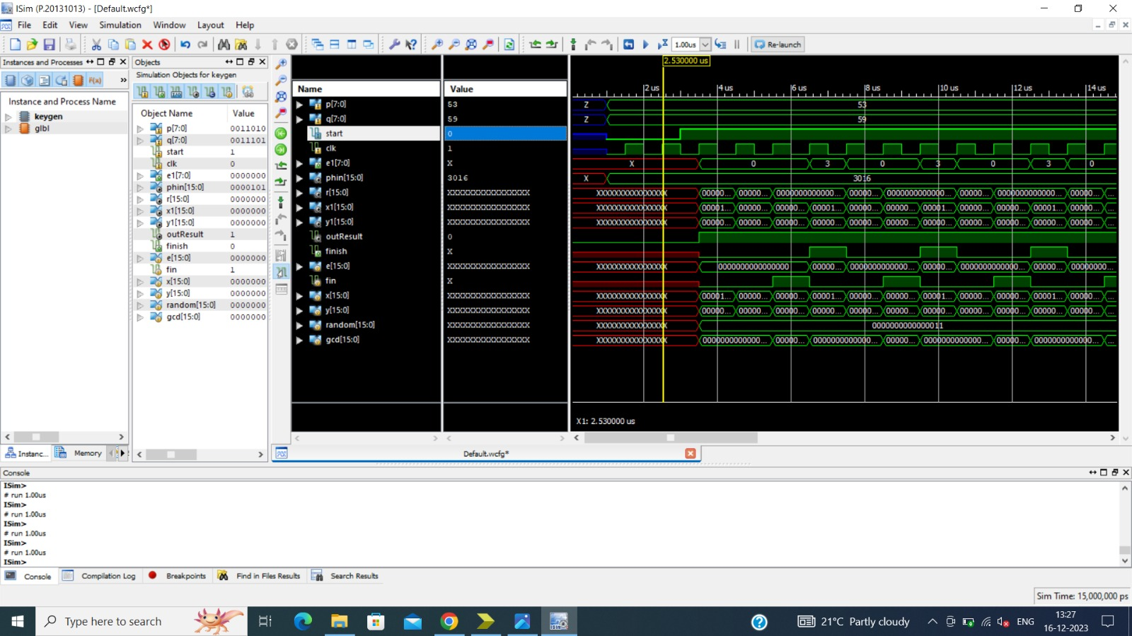
KEY GENERATION
(Public Key)
DEPARTMENT OF ELECTRONICS & COMMUNICATION

Slide 12
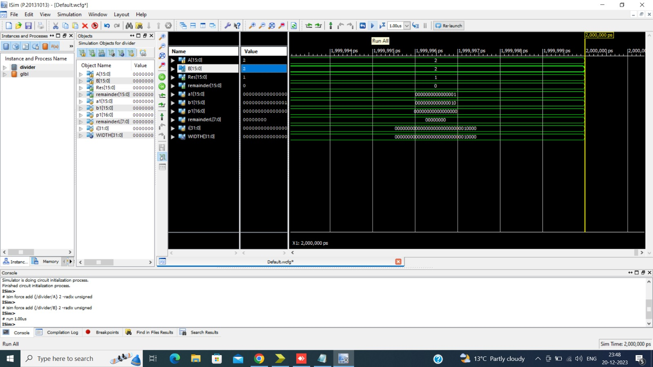
DIVIDER 16 bits
DEPARTMENT OF ELECTRONICS & COMMUNICATION

Slide 13
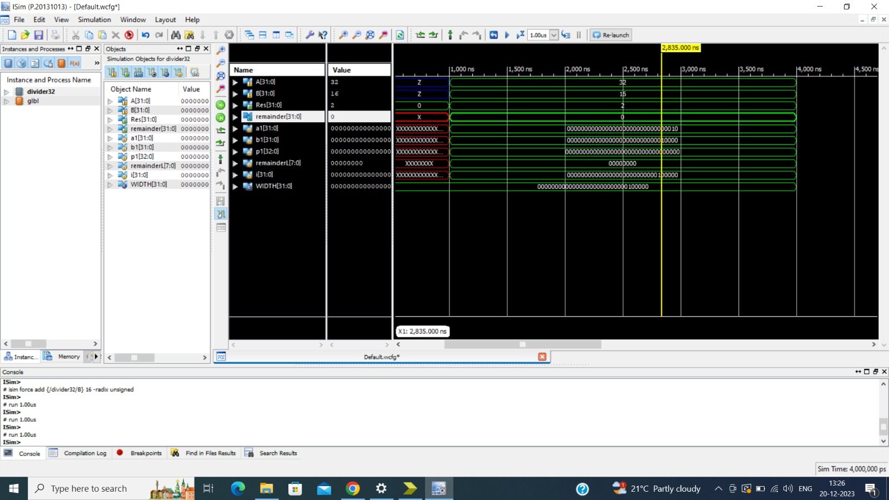
DIVIDER 32 bits
DEPARTMENT OF ELECTRONICS & COMMUNICATION

Slide 14
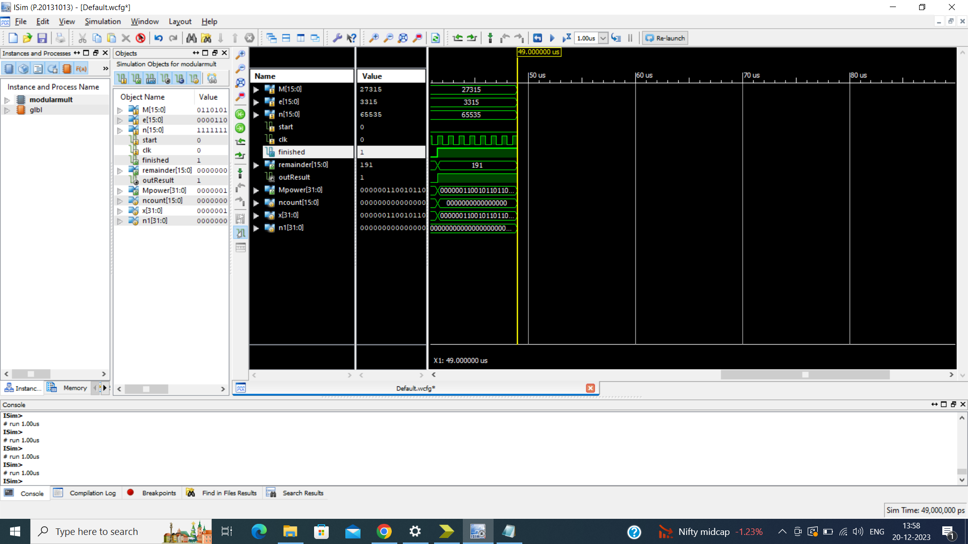
MODULO MULTIPLICATION
DEPARTMENT OF ELECTRONICS & COMMUNICATION

Slide 15
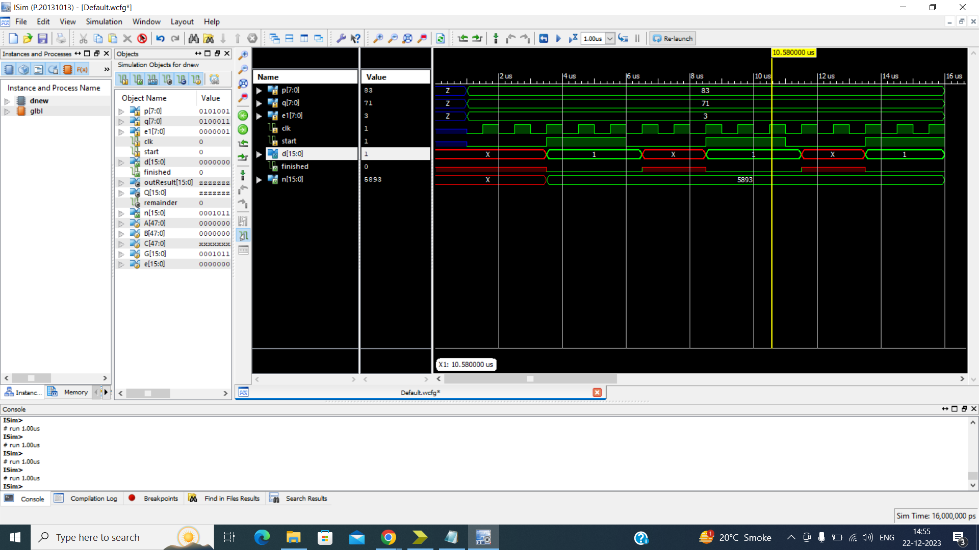
DECRYPTION
PRIVATE KEY (dnew.v) / (DATA RECEIVED)
DEPARTMENT OF ELECTRONICS & COMMUNICATION

Slide 16
REFERENCES / LIST OF ACCESSED RESOURCES:
https://ieeexplore.ieee.org/document/6021216
https://iopscience.iop.org/article/10.1088/1742-6596/1641/1/012042
https://scholarworks.calstate.edu/concern/theses/76537633k?locale=en
https://www.ijser.org/researchpaper/Implementation_of_RSA_Cryptosystem_Using_Verilog.pdf
https://www.ijert.org/research/implementation-of-rsa-algorithm-on-fpga-IJERTV1IS5454.pdf
https://www.researchgate.net/publication/257416064_Cryptosystem_An_Implementation_of_RSA_Using_Verilog
DEPARTMENT OF ELECTRONICS & COMMUNICATION

